Slide 1
NYKAA E-COMMERCE ANALYTICS :
FROM WEB SCRAPING TO MACHINE LEARNING
- Logiya Vidhyapathi
01

Slide 2
Analysis of product data from Nykaa, a leading beauty and personal care platform, to uncover market trends and customer preferences. Data scraped from 25 top brands, extracting key insights on pricing, discounts, ratings, reviews, and stock availability.
Objective
Identification of pricing and discount trends
Sentiment analysis through ratings & reviews
Product categorization and clustering for marketing strategies
Predictive modeling for sales insights
INTRODUCTION
02

Slide 3
DATA COLLECTION
Source Identification:
Nykaa Website
Tools Used:
Python
Beautiful Soup
Feature Extraction:
Product Brand & Name
Product Original & Offer Price
Product Discount
Product Ratings
Product Ratings & Reviews Count
Product Stock Status
03

Slide 4
01
Feature Engineering
02
Data Type Conversion
DATA CLEANING & PRE-PROCESSING
03
Handling Missing Values
04
Text Standardization
05
Duplicate Removal
04

Slide 5
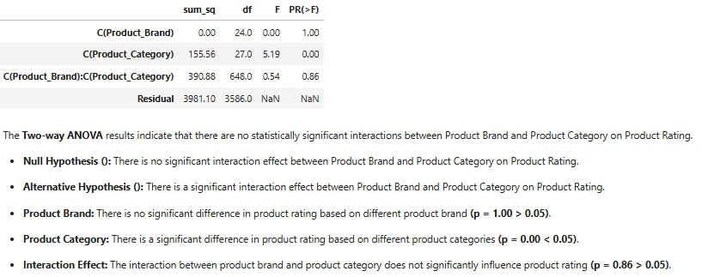
Two-Way ANOVA for Product Brand, Product Category & Product Rating
01
STATISTICAL ANALYSIS
Therefore, we fail to reject the Null Hypothesis for Interaction and Product Brand (i.e, don't have enough evidence to reject the null hypothesis).
05

Slide 6

Chi-Square Test for Product Category & Product Rating Scale
02
STATISTICAL ANALYSIS
Null Hypothesis (Ho): There is no association between the Product Categories and Product Rating Scale.
Alternative Hypothesis (Ha): There is an association between the Product Categories and Product Rating Scale.
Therefore. we reject the null hypothesis (i.e, we have enough evidence to support the alternative hypothesis) (p-value = 0.00 < 0.05).
06

Slide 7
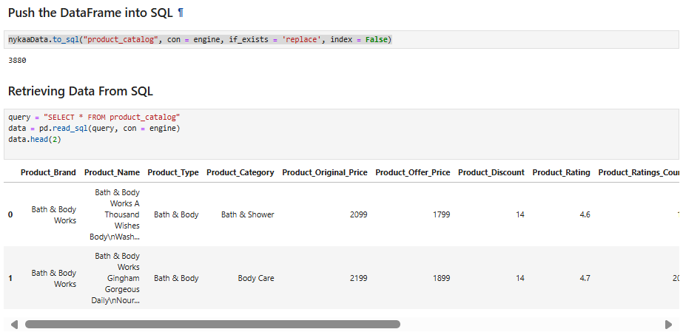
DATA STORAGE
TOOLS USED:
MySQL
SQLAlchemy
Pandas
STEPS:
Establish Connection
Create Database & Table
Insert Data
Verify Data
07

Slide 8
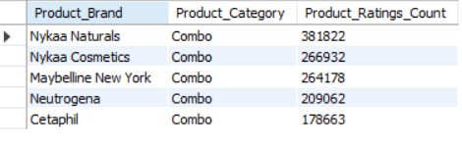
Retrieve Product Brand and their Product Category which has the Highest Ratings Count.
01
QUERY:
SELECT Product_Brand, Product_Category, MAX(Product_Ratings_Count) AS Product_Ratings_Count FROM product_catalog GROUP BY Product_Brand, Product_CategoryORDER BY Product_Ratings_Count DESC LIMIT 5;
OUTPUT:
SQL QUERIES
08

Slide 9
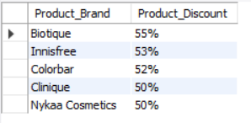
02
Find the Top 5 Brand which has the Highest Discount.
QUERY:
SELECT Product_Brand, CONCAT(MAX(Product_Discount), "%")
AS Product_Discount FROM product_catalog
GROUP BY Product_Brand ORDER BY Product_Discount DESC LIMIT 5;
OUTPUT:
SQL QUERIES
09

Slide 10
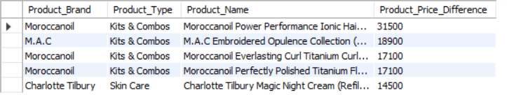
Find the Top 5 Products with the Largest Price Difference due to Offer Price.
03
QUERY:
SELECT Product_Brand, Product_Type, Product_Name, Product_Price_Difference FROM product_catalog
ORDER BY Product_Price_Difference DESC
LIMIT 5;
OUTPUT:
SQL QUERIES
10

Slide 11
MACHINE LEARNING:
SUPERVISED & UNSUPERVISED LEARNING
11

Slide 12
UNSUPERVISED LEARNING
01
K-Prototypes Clustering
02
DBSCAN Clustering
12

Slide 13
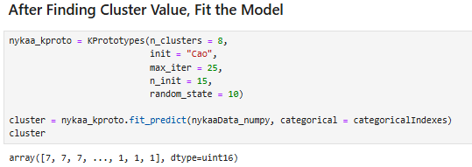
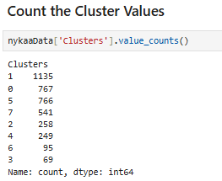
K-PROTOTYPES CLUSTERING
Feature Extraction:
Scaled numerical & encoded categorical data, applied PCA.
Algorithm:
K-Prototypes (Hybrid clustering for mixed data).
Training:
Elbow method for optimal clusters, trained using KPrototypes().
Evaluation:
Identified 8 clusters, calculated Cost Function, Silhouette Score, Davies-Bouldin Index, and visualized results.
13

Slide 14
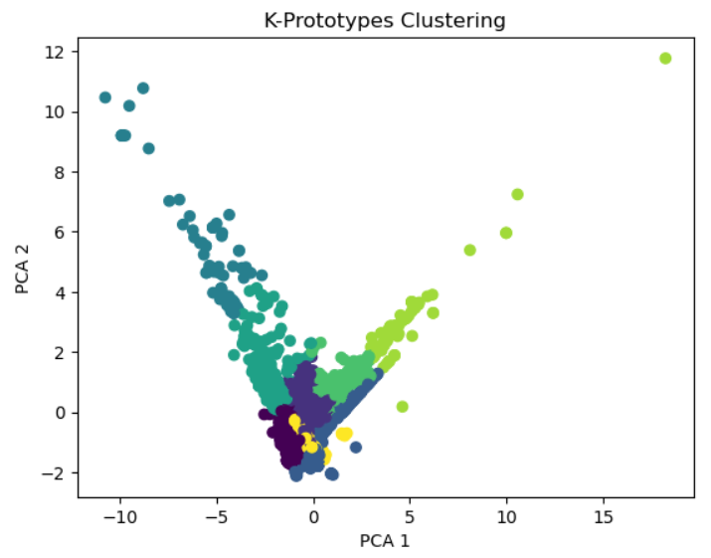
K-PROTOTYPES CLUSTERING VISUALIZATION
01
14

Slide 15
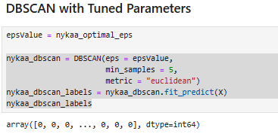
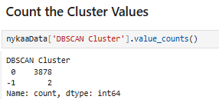
DBSCAN CLUSTERING
Feature Extraction:
Scaled numerical features for analysis.
Algorithm:
DBSCAN (Density-based Spatial Clustering of Applications with Noise).
Training:
DBSCAN(eps, min_samples, metric='euclidean') for clustering.
Evaluation:
Identified 2 clusters, calculated Silhouette Score, and visualized results.
15

Slide 16
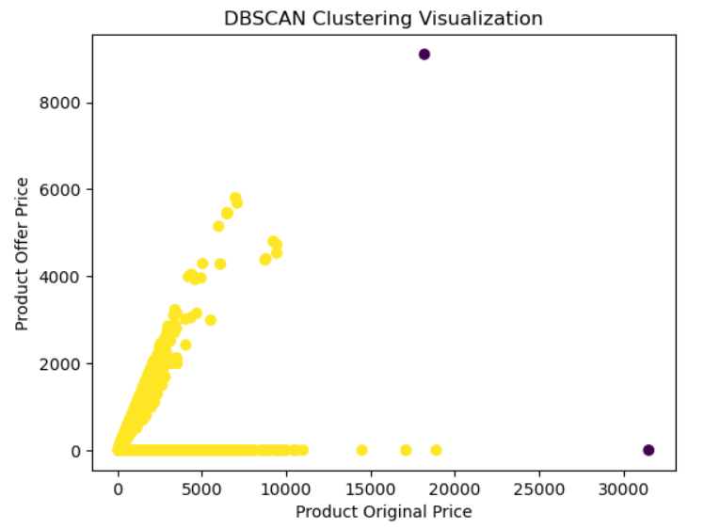
DBSCAN CLUSTERING VISUALIZATION
01
16

Slide 17


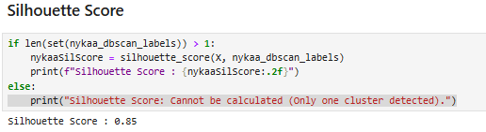
MODEL EVALUATION & PERFORMANCE
K-PROTOTYPES EVALUATION:
DBSCAN EVALUATION:
DBSCAN performs better for this dataset due to clearer cluster formation and structure.
17

Slide 18
01
Logistic Regression
02
Support Vector Machine
SUPERVISED LEARNING
03
K-Nearest Neighbors (KNN)
04
Random Forest
05
XGBoost
18

Slide 19
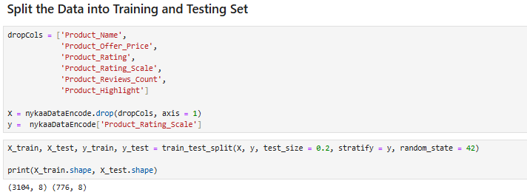
DATA SPLITTING FOR MODEL TRAINING & TESTING
Supervised Learning: Predicting Product Rating Scale
Predict the product rating scale (Low, Medium, High → 0, 1, 2) based on key product features.
For all models using train_test_split, the dataset is split into:
80% for Training (Used to train the model).
20% for Testing (Used to evaluate performance).
19

Slide 20
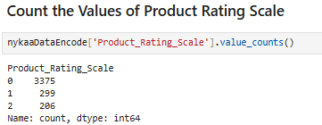
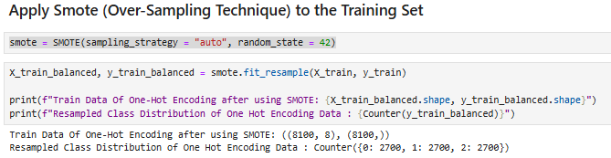
HANDLING IMBALANCE CLASS USING SMOTE
SMOTE : Synthetic Minority Over-sampling Technique.
Before Applying SMOTE:
The Product_Rating_Scale was highly imbalanced.
After Applying SMOTE:
Balanced dataset created using SMOTE to handle class imbalance.
20

Slide 21
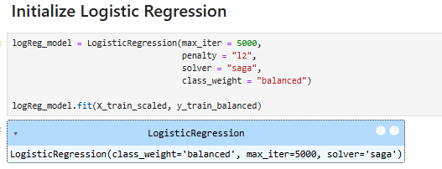
LOGISTIC REGRESSION
Feature Extraction:
Encoded categorical data using Binary, Label and Target Encoding & Scaled numerical using StandardScaler .
Algorithm:
Logistic Regression for multiclass classification.
Training:
Model trained using logReg_model.fit(X_train, y_train)
Evaluation:
Training Accuracy – 74%
Testing Accuracy – 80%
21

Slide 22
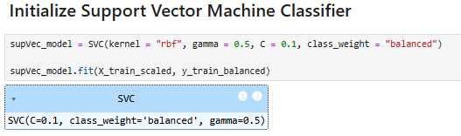
SUPPORT VECTOR MACHINE (SVM) CLASSIFIER
Feature Extraction:
Encoded categorical data using Binary, Label and Target Encoding & Scaled numerical using StandardScaler .
Algorithm:
SVM Classifier with kernel trick (RBF).
Training:
Model trained using supVec_model.fit(X_train, y_train)
Evaluation:
Training Accuracy – 75%
Testing Accuracy – 84%
22

Slide 23
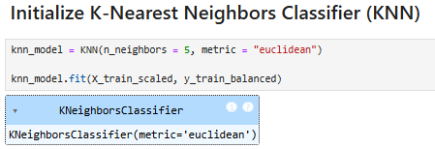
K-NEAREST NEIGHBORS (KNN) CLASSIFIER
Feature Extraction:
Encoded categorical data using Binary, Label and Target Encoding & Scaled numerical using StandardScaler .
Algorithm:
KNN Classifier.
Training:
Model trained using knn_model.fit(X_train, y_train) with nearest neighbors.
Evaluation:
Training Accuracy – 95%
Testing Accuracy – 89%
23

Slide 24
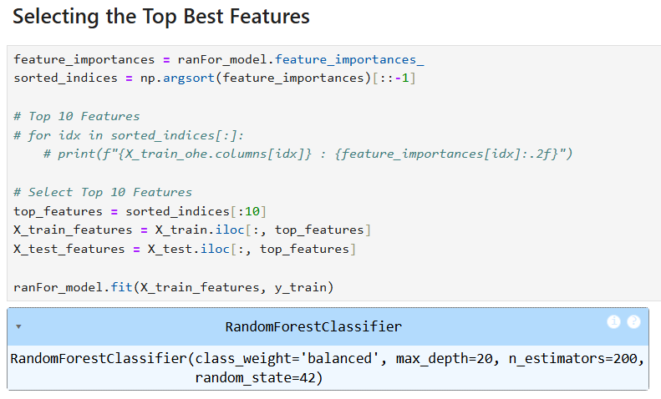
RANDOM FOREST CLASSIFIER
Feature Extraction:
Encoded categorical data using Binary, Label and One-Hot Encoding & Scaled numerical using StandardScaler .
Algorithm: Ensemble of decision trees (Bagging).
Training:
Model trained using rf_model.fit(X_train, y_train)
Evaluation:
Before Feature Selection:
Training Accuracy – 100%
Testing Accuracy – 93%
After Selecting Top Features
Training Accuracy – 99%
Testing Accuracy – 93%
24

Slide 25
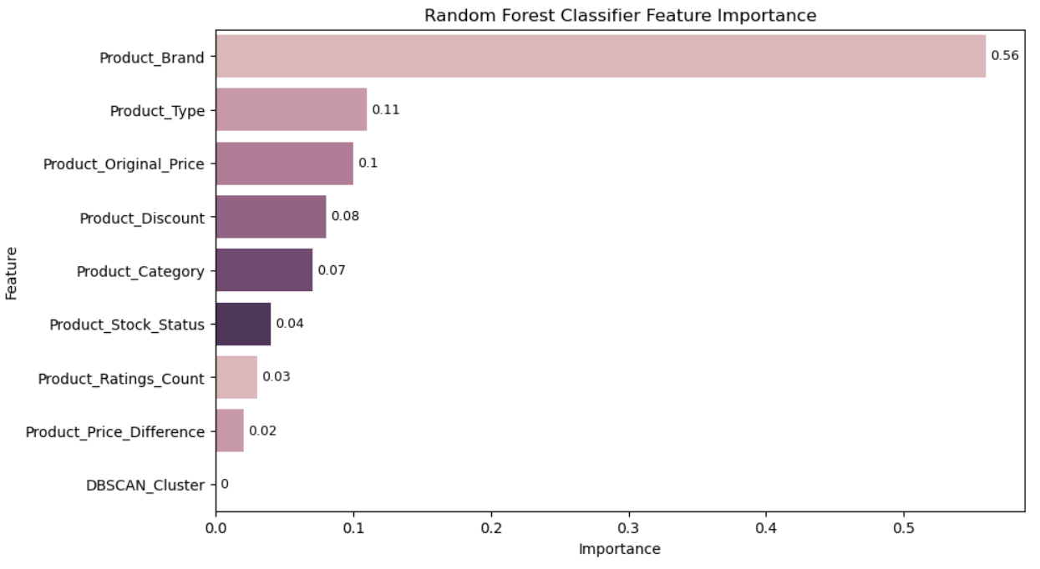
FEATURE IMPORATNCE OF RANDOM FOREST CLASSIFIER
01
25

Slide 26
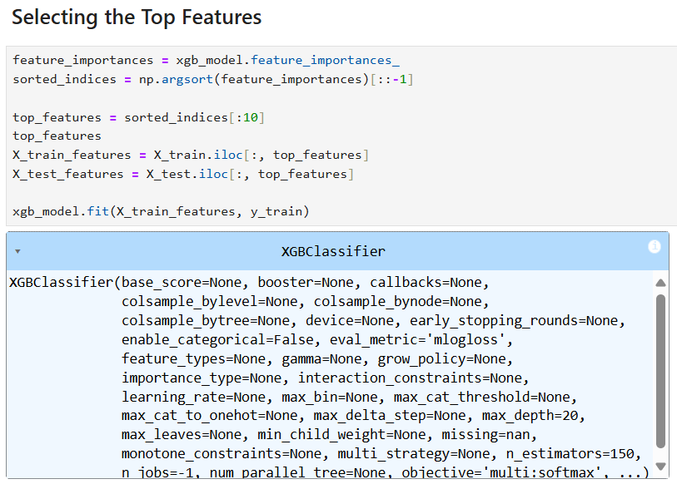
XGBOOST CLASSIFIER
Feature Extraction:
Encoded categorical data using Binary, Label and One-Hot Encoding & Scaled numerical using StandardScaler .
Algorithm: Gradient Boosting (Tree-Based).
Training:
Model trained using xgb_model.fit(X_train, y_train).
Evaluation:
Before Feature Selection:
Training Accuracy – 100%
Testing Accuracy – 91%
After Selecting Top Features
Training Accuracy – 100%
Testing Accuracy – 94%
26

Slide 27
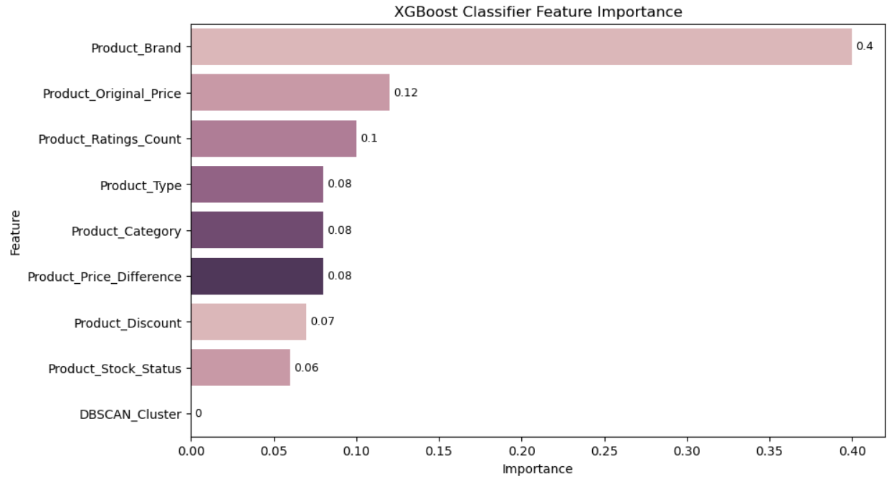
FEATURE IMPORATNCE OF XGBOOST CLASSIFIER
01
27

Slide 28
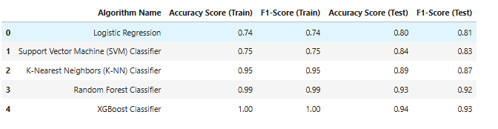
MODEL EVALUATION & PERFORMANCE
XGBoost Classifier is the best-performing model based on test accuracy and F1-score.
Evaluation:
Test Accuracy: 94% (Highest among all models)
F1-Score: 93% (Indicates balanced precision & recall)
XGBoost is selected for hyperparameter tuning to further optimize performance.
28

Slide 29
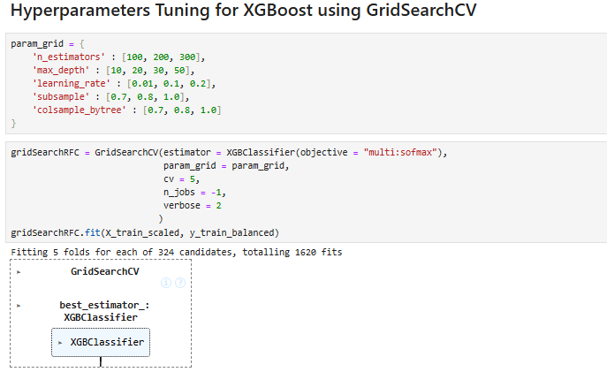
HYPERPARAMETER TUNING FOR XGBOOST CLASSIFIER USING GRIDSEARCHCV
Grid Search Parameter:
29

Slide 30
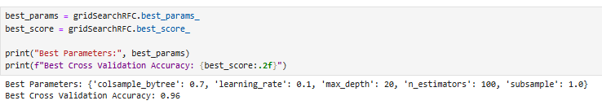
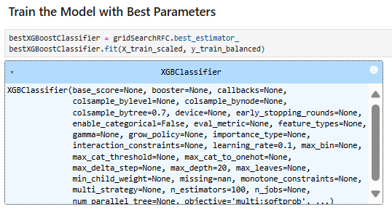
Best Parameters Found:
Model Training with Best Parameters:
30

Slide 31
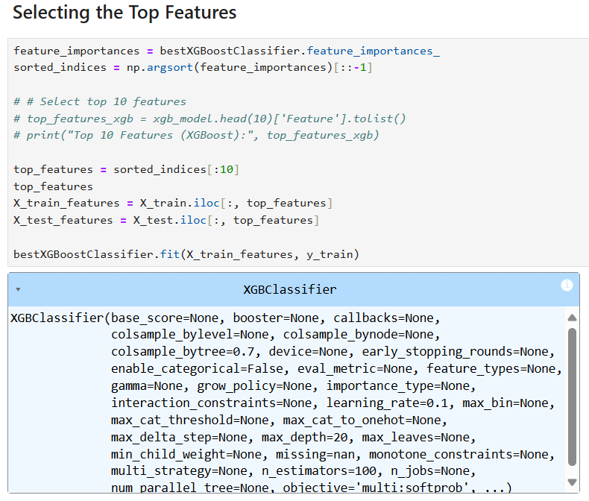
Selecting the Top Features:
Evaluation:
Before Feature Selection:
Training Accuracy – 99%
Testing Accuracy – 92%
After Selecting Top Features
Training Accuracy – 100%
Testing Accuracy – 94%
31

Slide 32
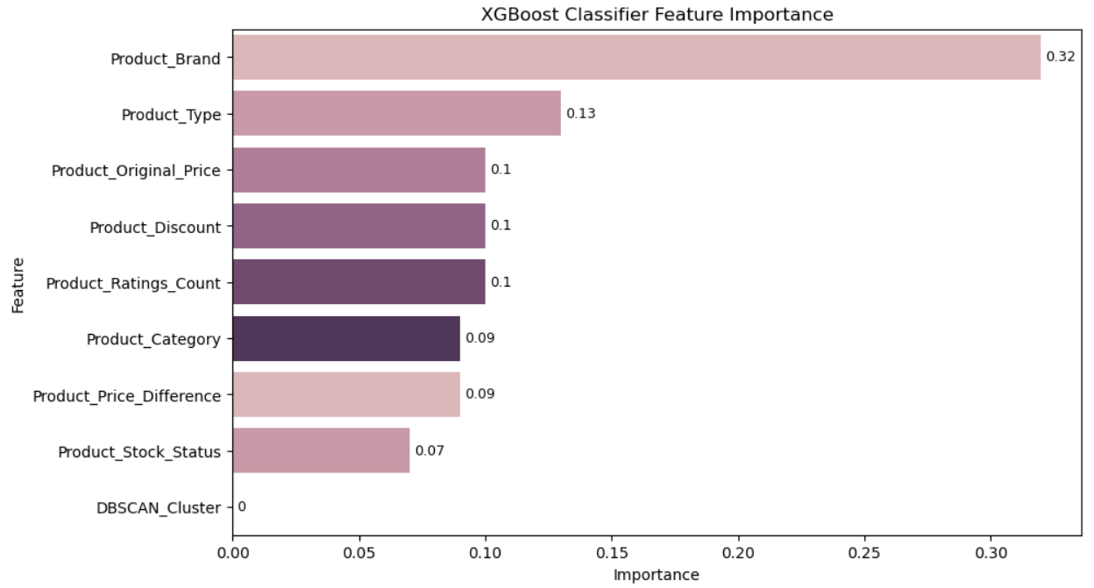
FEATURE IMPORATNCE OF XGBOOST CLASSIFIER WITH TUNED PARAMETERS
01
32

Slide 33
PERFORMANCE COMPARISON OF BEFORE & AFTER TUNING
Performance Comparison (Before & After Tuning):
Before Tuning:
Training Accuracy – 100%
Testing Accuracy – 94%
After Tuning
Training Accuracy – 100%
Testing Accuracy – 94%
No change in accuracy, the model was already well-optimized.
33

Slide 34
Key Insights:
Model Performance
Feature Selection
SMOTE Applied
Hyperparameter Tuning
Business Recommendations:
Leverage Model Insights
Monitor Model Stability
Optimize Resource Allocation
Consider Further Enhancements
KEYS INSIGHTS & BUSINESS RECOMMENDATIONS
01
34

Slide 35
Conclusion:
Optimized Model:
Feature Selection Impact
SMOTE Effectiveness
Hyperparameter Tuning
Future Works:
Fine-tuning Further
Real-time Implementation
Feature Engineering
Alternative Models
CONCLUSION & FUTURE WORKS
01
35

Slide 36
THANK
YOU
36

